Slide 1


Paul Dean, Soo Bin Hwang, Seunghwa Jun
UofTSTG201905DATA3 ｜ Oct 10, 2019
CREATING
.
.
.
(Maybe the World’s First!)
.
.
.
Economics Book!
With Interactive Online References!!

Slide 2
1 | Project Outline
2 | Reference List & Search
3 | Reference Dashboard
4 | Latest Articles

Slide 3
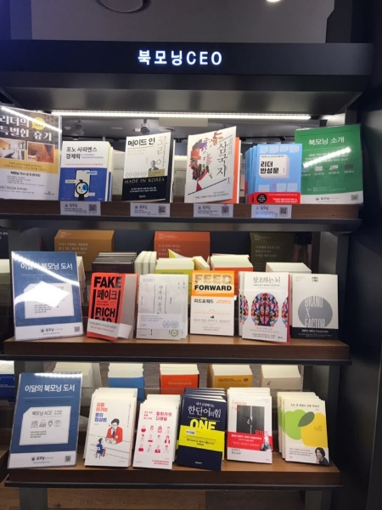

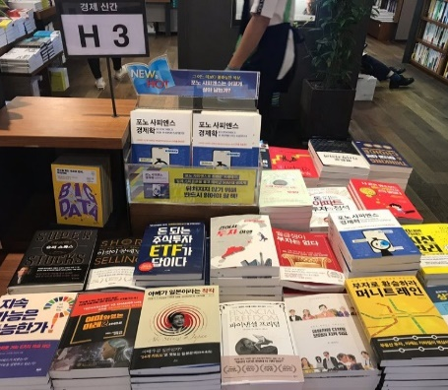
Outline
1
Creating the Online Reference Database and the Interactive Functions for the book
titled << Phono Sapiens Economics : The New ‘Human-Centered Digital Economy >>
The book was published in Korean in this September (paper and e-book) and will be e-book published in English in January 2020.
Team members’ names will be listed in the ‘Acknowledgements.’
[ In Korean bookstores ]

Slide 4
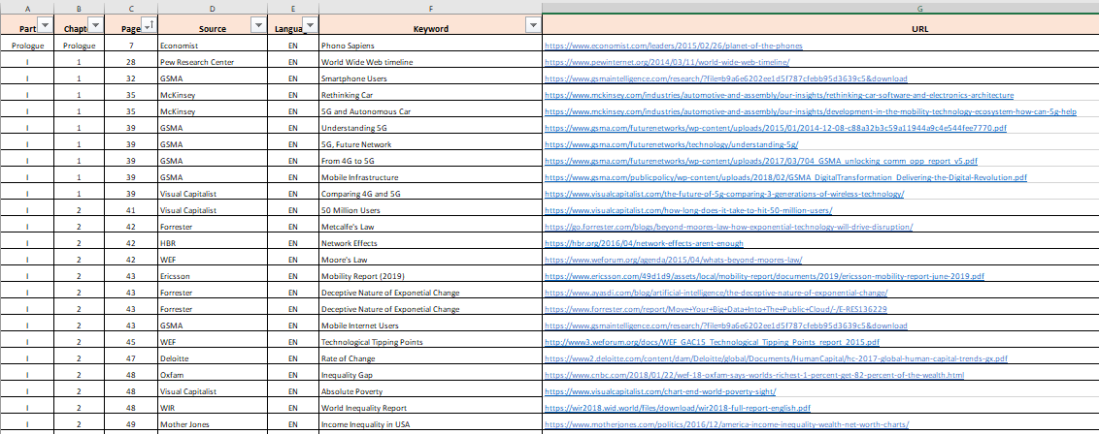
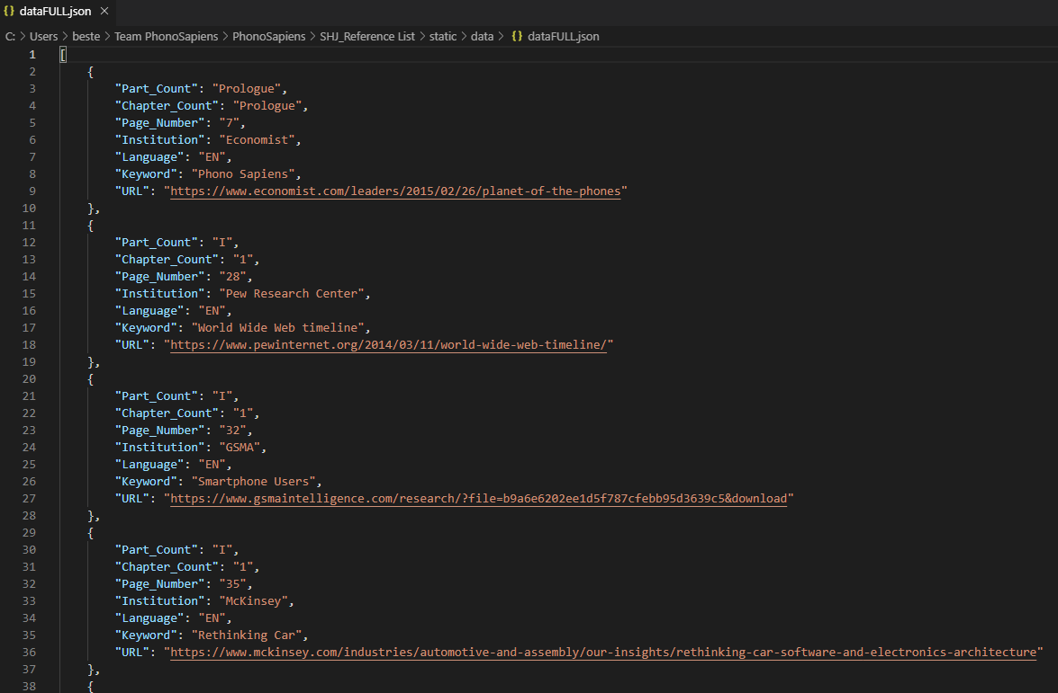
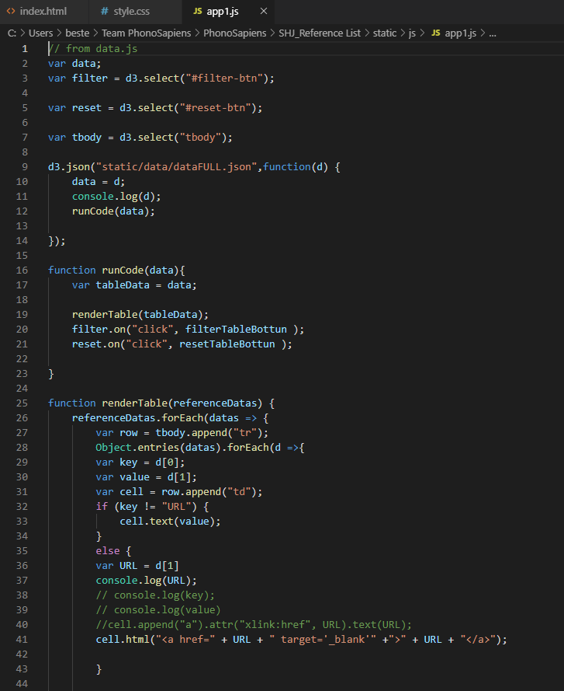
Reference List & Search
2
The data set was manually and tediously created by the author
and then an web page with multiple search categories are coded!
[ Work Flow ]
Data Set
Excel
(213 Records)
Converting
to Jason
(Python)
Coding!
(HTML, CSS, D3.js,
and Java Script)
Tada!

Slide 5
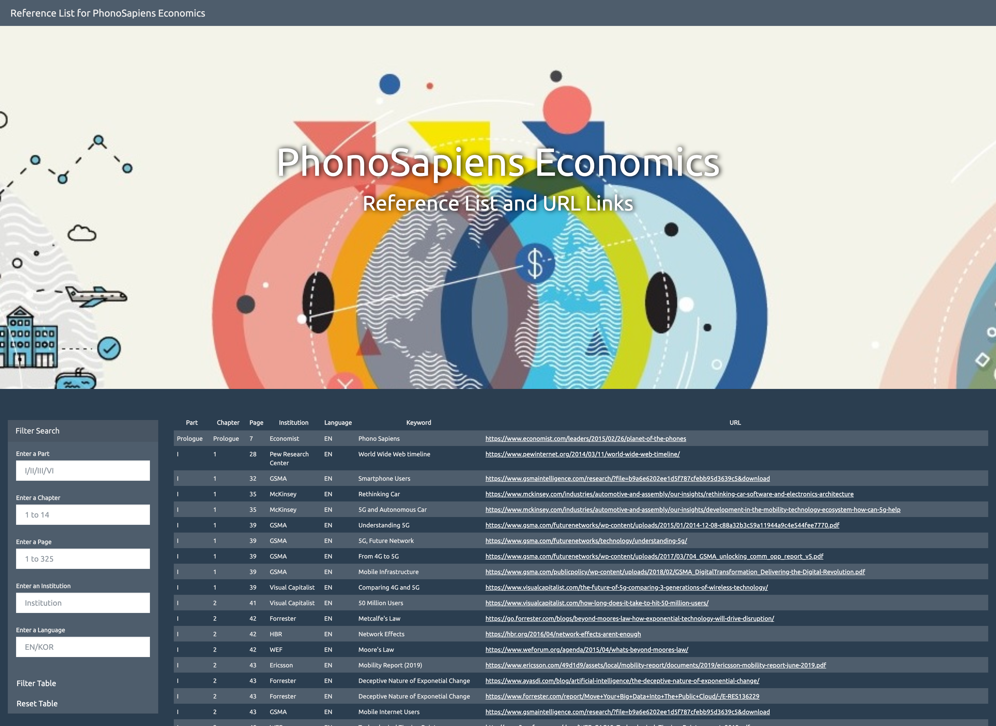
5 Filter Searches (Part / Chapter / Page / Institution / Language)
Automatic Reference Table with URLs
(When clicked, it opens a new window of the linked website)

Slide 6
1 | Outline of the Project
2 | Reference List & Search
3 | Reference Dashboard
4 | Latest Articles

Slide 7
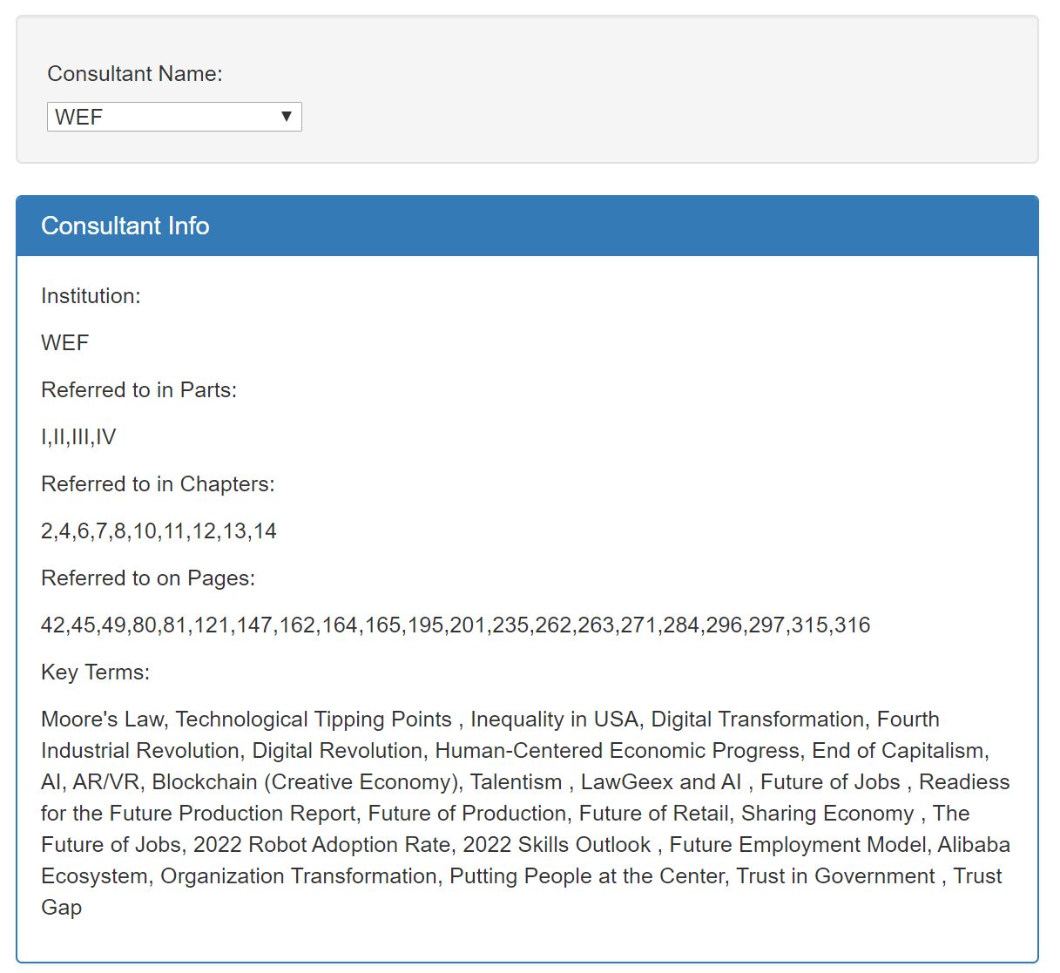
Reference Dashboard
3
Displaying detailed consultant info using dropdown menu

Slide 8
Reference Dashboard
3
Overview of Steps
Import data from JSON file into app.js using d3.json().then
Collect the consultant name selection using element.property(‘value’)
Filter the data using that consultant name,
and create lists of unique parts, chapters,
etc. using if(list.includes(item)) statements
Print data to the info box by
iterating through
those lists

Slide 9
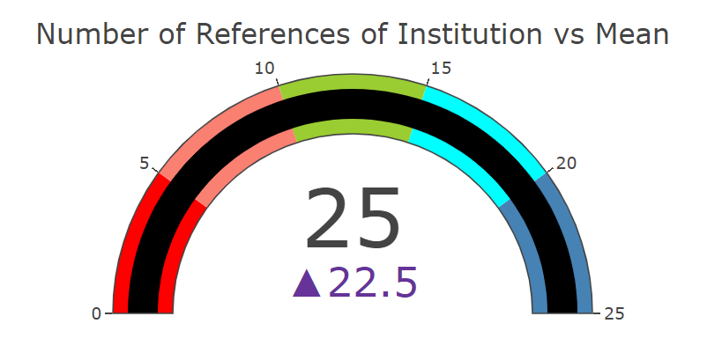
Reference Dashboard
3
Displaying gauge info using dropdown menu

Slide 10
Reference Dashboard
5
Overview of Steps
Import data from JSON file into app.js using d3.json().then
Collect the consultant name selection using element.property(‘value’)
Filter the data using that consultant name,
and collect the number of times that consultant name was referenced
Feed that reference count amount into plotly using mode:
mode: 'gauge+number +delta'

Slide 11
1 | Outline of the Project
2 | Reference List & Search
3 | Reference Dashboard
4 | Latest Articles

Slide 12
Scraping Latest Articles
4
Visit each website and scrape the top search result.
Insert company images and show titles of each article retrieved.
[ Methods used ]
Python (Flask, Jupyter Notebook)
JavaScript (Bootstrap)
MongoDB
HTML
[ Python libraries used ]
Flask Requests
Pymongo Time
BeautifulSoup Splinter
Creating a python
Flask app for
scraping and
setting up
a MongoDB
database
…
(Running
the app)
Trying scraping on
Jupyter Notebook
Profit..!

Slide 13
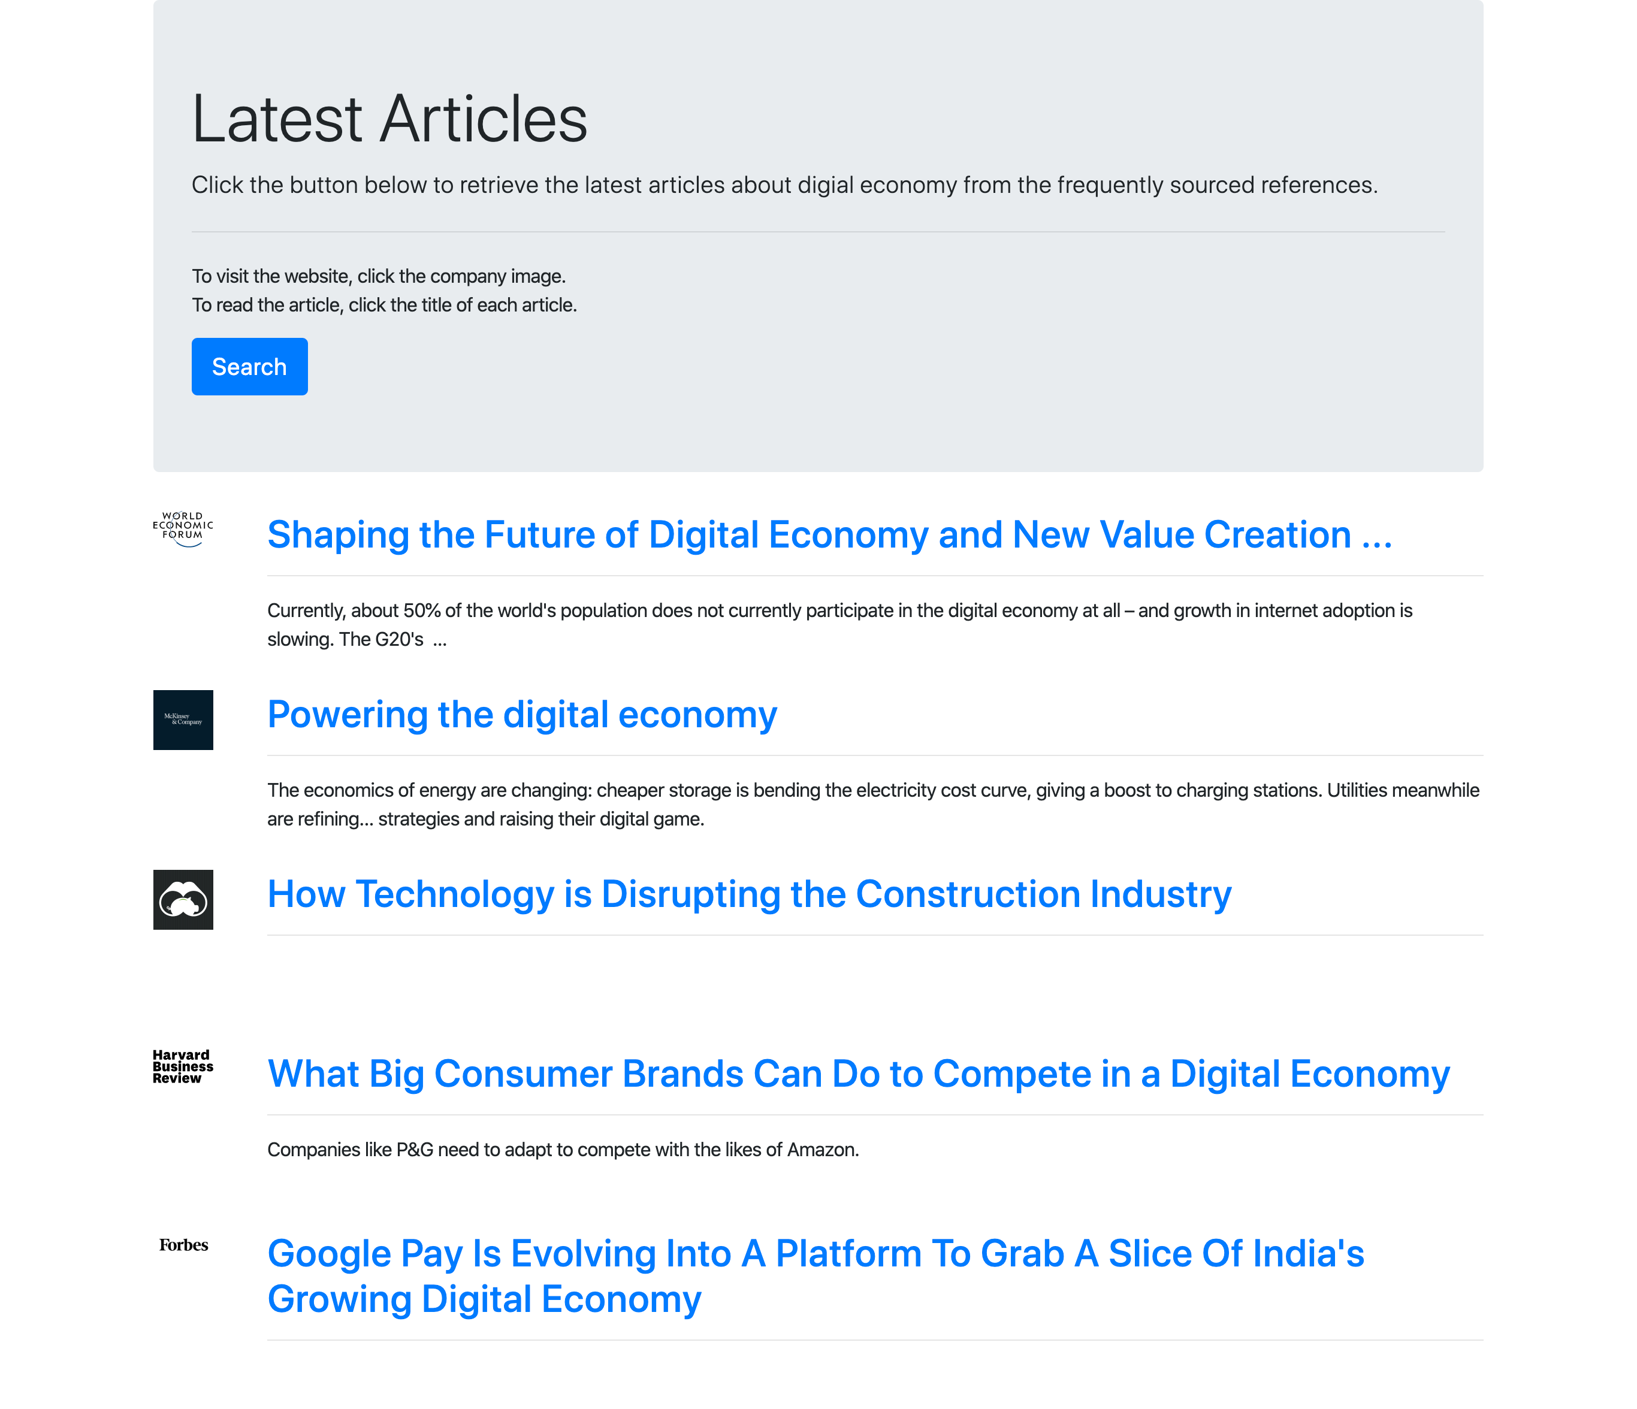

Slide 14
Thank you~!

